Slide 1
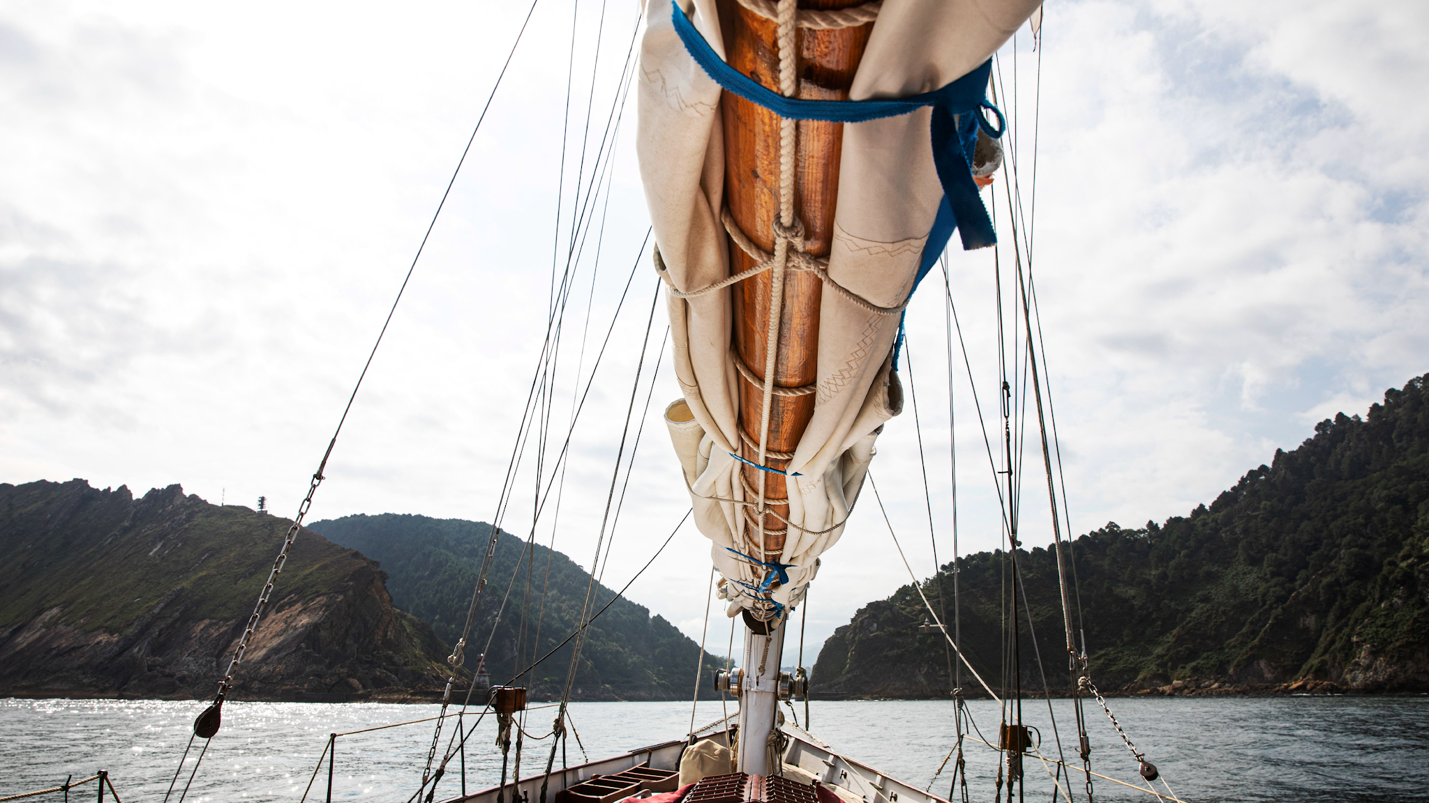
Group 1 Project 3

Slide 2

David, Juanita and Tim present: Shipwrecks of South Australia
Story telling and visualisation with Historical South Australian Data

Slide 3

The Team
David Baldwin
Juanita Sands
Tim Cook

Slide 4

TABLE OF CONTENTS
01
The Datset
02
The Method
03
Live Demo
04
End Step
Description and source for the data set
Tools, libraries and data pipeline used to create the page
Live Demo of the site and some fun data points
Attribution and final points

Slide 5

01
The Dataset
Data SA - Shipwrecks

Slide 6

705 Ship Wrecks
Between 1836 and 2002

Slide 7
Data SA - Shipwrecks
https://data.sa.gov.au/data/dataset/shipwrecks
An extract from the South Australian Shipwrecks Database
Includes all known shipwrecks in SA and adjacent waters
Incorporates wrecks from the Register of Historic Shipwrecks and Register of Historic Relics
Data only available for download, no API
GeoJSON format

Slide 8
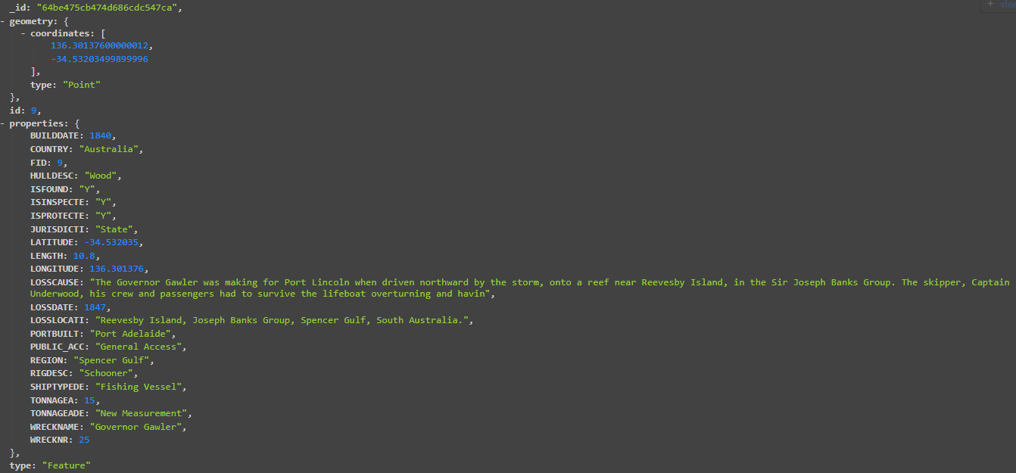
Shipwreck Data Example

Slide 9
Flask API Routes
/documents - All documents in data set
/documents/<int:start_year>/<int:end_year> - filtered by year for slider
/documents/ship/<ship_type> - Filtered by ship type for legend and icons

Slide 10
Data SA - Shipwrecks
Data on 700+ shipwrecks in SA waters
Lots of data for each wreck, but we have chosen to focus on:
Build Date
Loss Date (Filtering out ships that do not have this)
Country
Hull Description
Loss Cause
Region
Rig Description (Type of ship)

Slide 11

Story Telling with Historical Data
Loss Cause
Ship Types
Loss Date
Each feature tells a small story about the ship that was wrecked. Some are super fun and interesting.
Allows for beautiful visualisation
Generated from pulling the 4-digit year value from the inconsistently formatted LOSSDATE property

Slide 12
01
The Method
Front End and Backend

Slide 13
Back & Front End Libraries
Python – Jupyter notebook for data cleaning
MongoDB – GeoJSON data loaded into MongoDB
FLASK API – Multiple API routes created with Flask to deliver all the data to the Javascript Front end.
FLASK CORS – Adding functionality to FLASK to navigate the Chrome CORS.
D3.js – Used to Import the GeoJSON from the API
Leaflet – to map the data, including custom icons for different Rig Types
Jquery – minor extra functionality
Plotly – Data Visualisation
Bootstrap – Making the HTML pretty
noUiSlider – Slider function for year selection

Slide 14










The Data Pipeline
pyMongo
noUiSlider

Slide 15
What we created with this data set and tools…
Map of SA Shipwrecks
Story Box
Map Filters
Visualisations
Slider
An attractive map that shows all the Shipwrecks in the Dataset
Tells a short story about each ship. Some have more detail than others
Functional Slider for year selection that updates the map and charts
Filter the map using the legend to see different ship types and data years
Dataset statistics visualised with Pyplot updating based on the slider year

Slide 16
Live Demo Time!

Slide 17
The End Step
Challenges, Opportunities, and Attribution

Slide 18
Challenges
HTML Layout is challenging
Untidy data and trying to do too much in JS.
Issues with CORS and FLASK
Bootstrap is a powerful library, but complicated and finicky!
Way too much time spent trying to get around CORS and other annoying errors!
JavaScript is not much fun for data manipulation and cleaning. We should have done this in Python earlier.
Some data was cleansed prior to commencing creating the visualisations but upon working with the data it was clear further cleansing was required, this was then updated in python and brought in via the flask
Github challenges
Sometimes Github feels way more complicated than it needs to be!
Data Inconsistencies
Different combined data sets by Data.sa.gov.au lead to some of the descriptions being cut short.

Slide 19
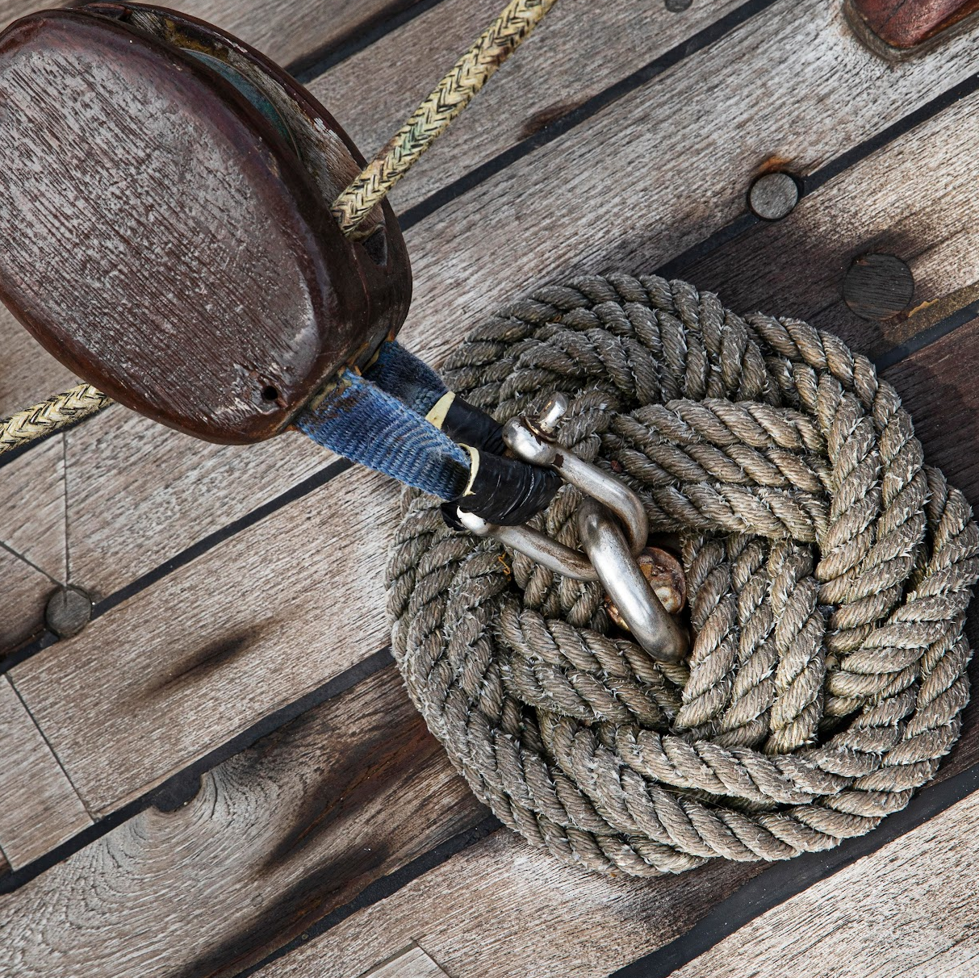
Opportunities for further exploration
Lots of data
Expanded mapping
Time Series
Improving the Dashboard
Expanded Story Telling
Reworked Backend
Dataset has so many options to explore
Options for clustering points, regional analyis etc…
Explore order of accidents and look for patterns
The webpage could definetly have a better layout
Which ships lasted the longest or shortest period of time
Improvements could be made to the FLASK API to improve mapping and dataflow options. MongoDB & FLASK hosted rather than local.

Slide 20
TRUE OR FALSE
QUESTIONS
T
F
Were there any pirates in our data?
T
F
Is the loss date the main driver for our shipwrecks webpage?
T
F
Can ships be wrecked on land?
T
F
Is the Shipwreck data for only South Australia?
T
F
Are their only one type of ship that has been wrecked in SA?
T
F
Were there 685 ship wrecks mapped?
Notes:
Just for fun and to get everybody involved??

Slide 21
— Pirates (Probably!)
“Yarrrrrrrrrrrrrr”
(Translation: Any questions?)

Slide 22
THANK YOU

Slide 23


